Slide 1
Kubernetes Intermediate
Training

Slide 2
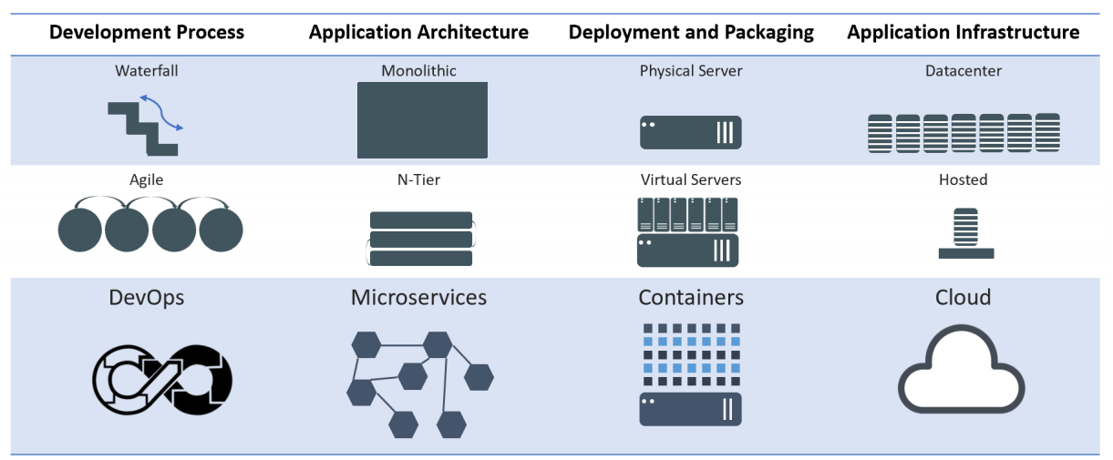
Evolution of Computing
Notes:
Mention WHY the evolution and benefits of adapting to new practices

Slide 3
Architecture Overview
Masters - Acts as the primary control plane for Kubernetes. Masters are responsible at a minimum for running the API Server, scheduler, and cluster controller. They commonly also manage storing cluster state, cloud-provider specific components and other cluster essential services.
Nodes - Are the ‘workers’ of a Kubernetes cluster. They run a minimal agent that manages the node itself, and are tasked with executing workloads as designated by the master.

Slide 4
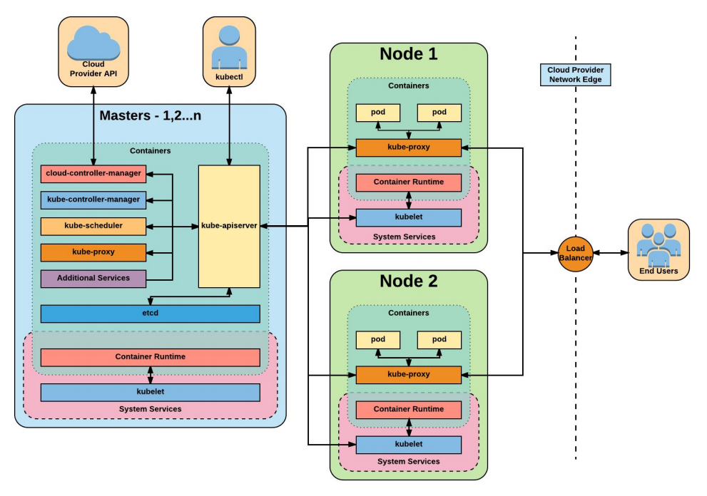

Slide 5
Installation
Install Minikube and Kubectl
https://github.com/arjunachari12/install-jenkins-container/blob/main/kubernetes.md

Slide 6
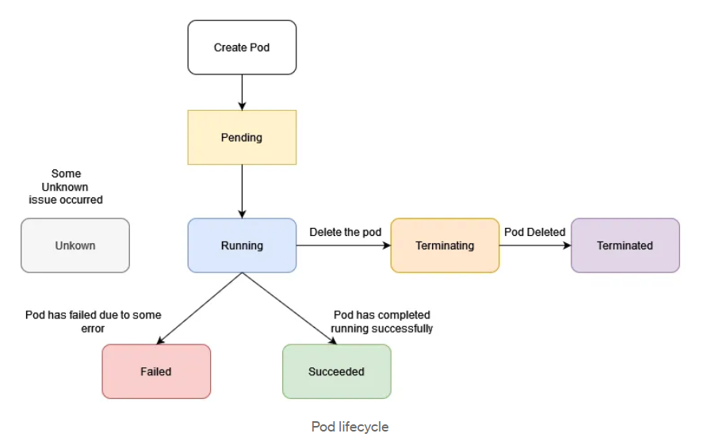
Pods lifecycle

Slide 7
Exercise: Run image as pod
Hands-on steps:
Step 1: Open VS code and create new folder
Step 2 : write manifest file pod.yml, copy code from below link
https://github.com/arjunachari12/k8s-learn/blob/main/pod.yml
Step 3: Execute pod.yml file using below command
kubectl create -f pod.yml
Step 4: You should see pod created message
Step 5: run below commands
kubectl get pod
kubeclt describe pod pod
kubectl delete pod

Slide 8
Assignment: Run multiple images as pod
Hands-on steps:
Step 1: Open VS code and create new folder
Step 2 : write manifest file pod.yml, copy code from below link
https://github.com/arjunachari12/k8s-learn/blob/main/pod2.yml
Step 3: Execute pod.yml file using below command
kubectl create -f pod2.yml
Step 4: You should see pod created message
Step 5: run below commands
kubectl get pod
kubeclt describe pod pod1
kubectl delete pod pod1

Slide 9
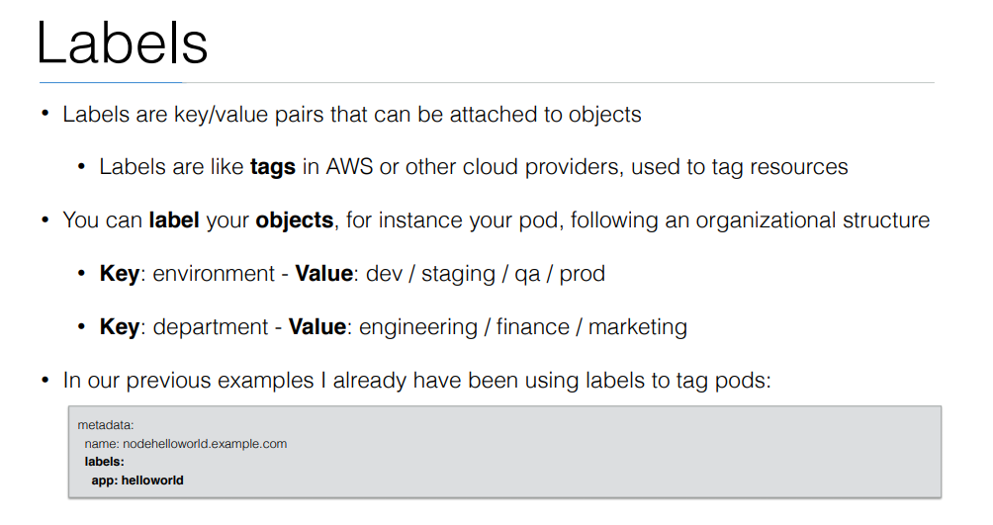

Slide 10
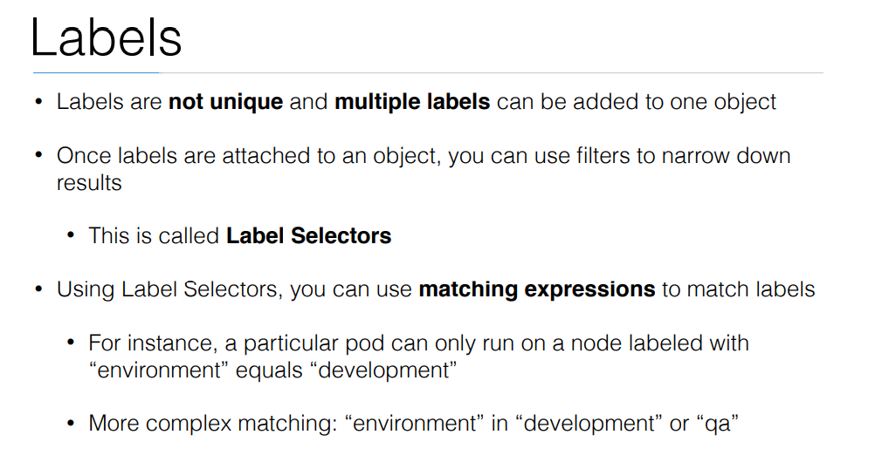

Slide 11
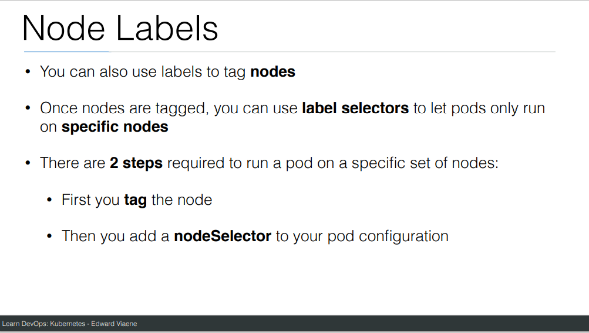

Slide 12
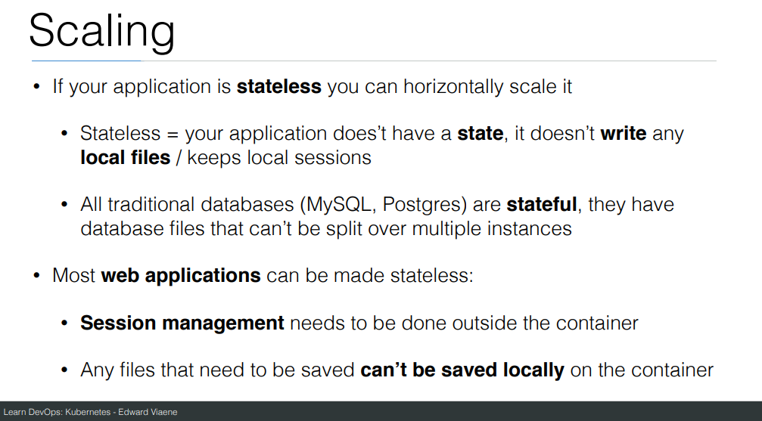

Slide 13
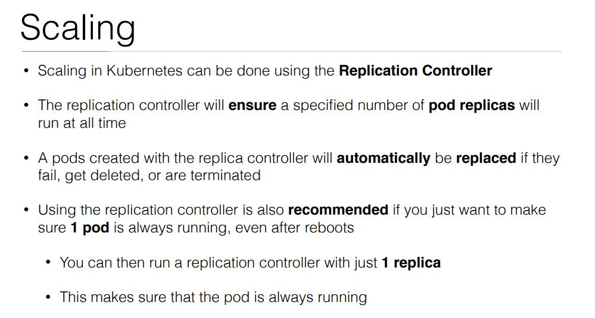

Slide 14
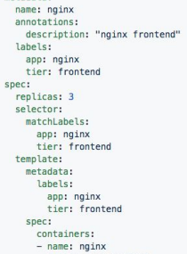
ReplicaSet
Generated ReplicaSet from Deployment spec.

Slide 15
Replicaset
kubectl create -f helloworld_replicaset.yaml
kubectl get rs
kubectl autoscale rs helloworld-controller --max=5
kubectl delete rs helloworld-controller
kubectl edit pods helloworld-controller-9jlsq

Slide 16
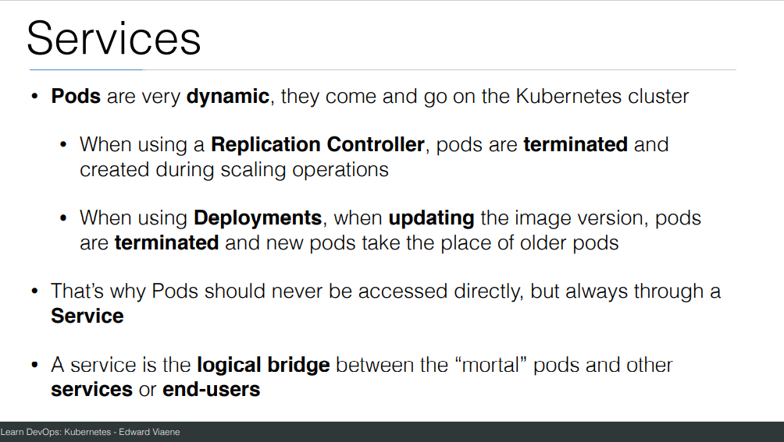

Slide 17
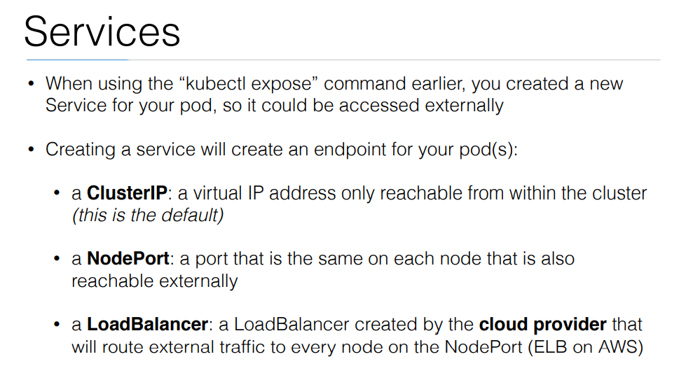

Slide 18
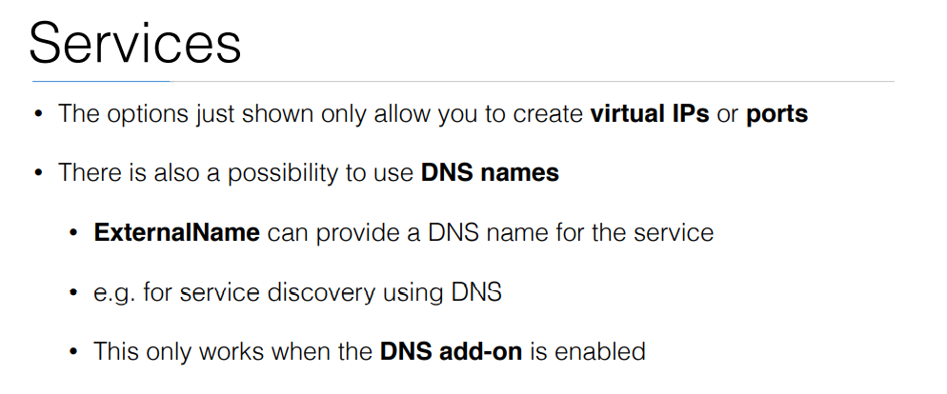

Slide 19
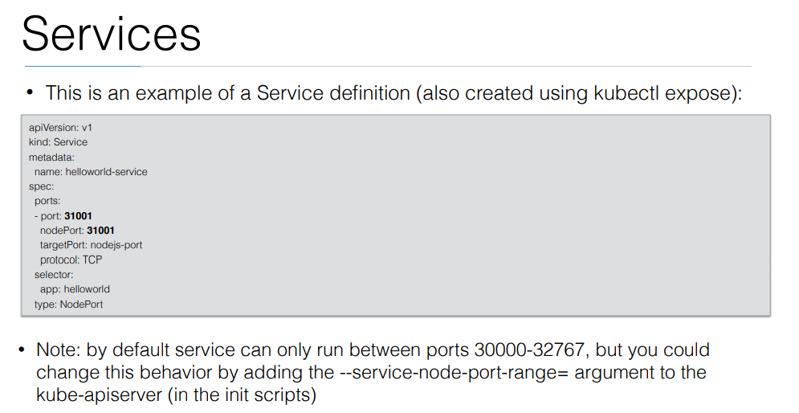

Slide 20
Exercise: Run image as pod
Hands-on steps:
Step 1: Open VS code and create new folder
Step 2 : write manifest file pod3.yml, copy code from below link
https://github.com/arjunachari12/k8s-learn/blob/main/pod3.yml
Step 3: Execute pod.yml file using below command
kubectl create -f pod3.yml
Step 4: You should see pod created message
Step 5: run below commands
kubectl get pod
kubeclt describe pod pod3

Slide 21
Exercise: Expose pod as Service
Hands-on steps:
Step 1: Open VS code and create new folder
Step 2 : write manifest file pod3-service.yml, copy code from below link
https://github.com/arjunachari12/k8s-learn/blob/main/pod3-service.yml
Step 3: Execute pod3-service.yml file using below command
kubectl create -f pod3-service.yml
Step 4: You should see pod created message

Slide 22
Exercise: Expose pod as Service
Hands-on steps:
Step 5: run below commands
kubectl get pod
kubeclt describe pod pod3
kubectl get svc
minikube service helloworld-service --url
kubectl describe svc helloworld-service
kubectl describe svc
Kubectl get svc
kubectl delete svc helloworld-nodeport-service.yml

Slide 23
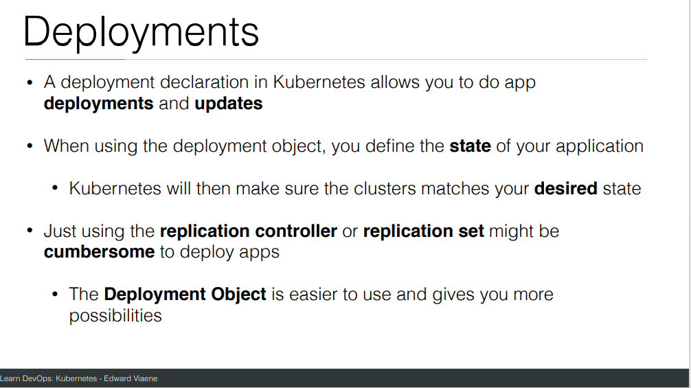

Slide 24
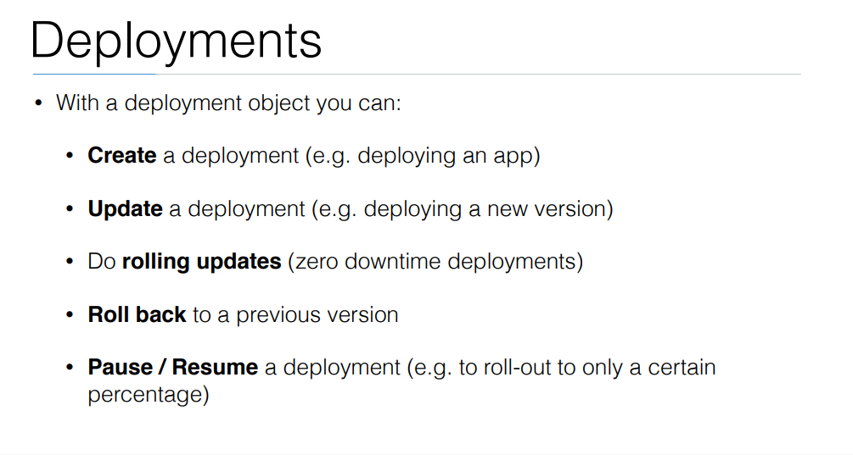

Slide 25
commands
Create a file called helloworld-deployment.yaml
Copy content from https://github.com/arjunachari12/k8s-learn/blob/main/helloworld-deployment.yml
kubectl create -f helloworld-deployment.yaml
kubectl get deployments
kubectl get rs
kubectl get pods
kubectl get pods --show-labels
kubectl rollout status deployment/helloworld-deployment

Slide 26
commands
Created new version of docker image and uploaded in docker hub
kubectl expose deployment helloworld-deployment --type=NodePort
kubectl get svc
minikube service helloworld-deployment --url
Curl url
kubectl set image deployment/helloworld-deployment k8s-demo=arjunachari12/k8s-demo:2
see
Curl to see new version

Slide 27
commands
kubectl get pods
kubectl rollout history deployment/helloworld-deployment
kubectl get pods
kubectl rollout undo deployment/helloworld-deployment
Curl again #modify history count
kubectl edit deployment/helloworld-deployment

Slide 28
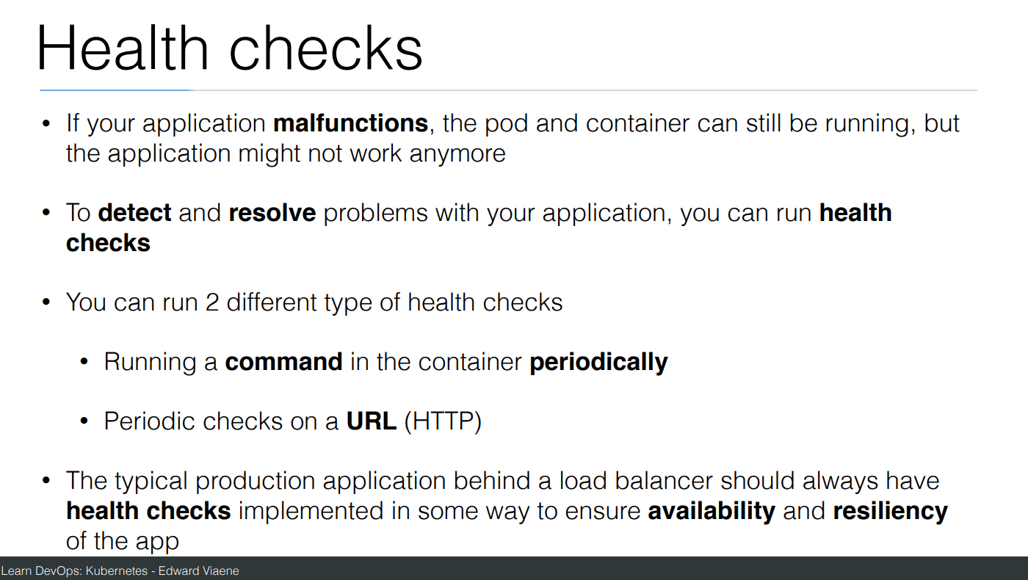

Slide 29
Commands
Create a file helloworld-healthcheck.yml
kubectl create -f helloworld-healthcheck.yml
kubectl describe pod helloworld-deployment-7cfbb8fccf-78bxk
kubectl edit deployment/helloworld-deployment
#This will immediately run
kubectl create -f helloworld-healthcheck.yml && watch -n1 kubectl get pods

Slide 30
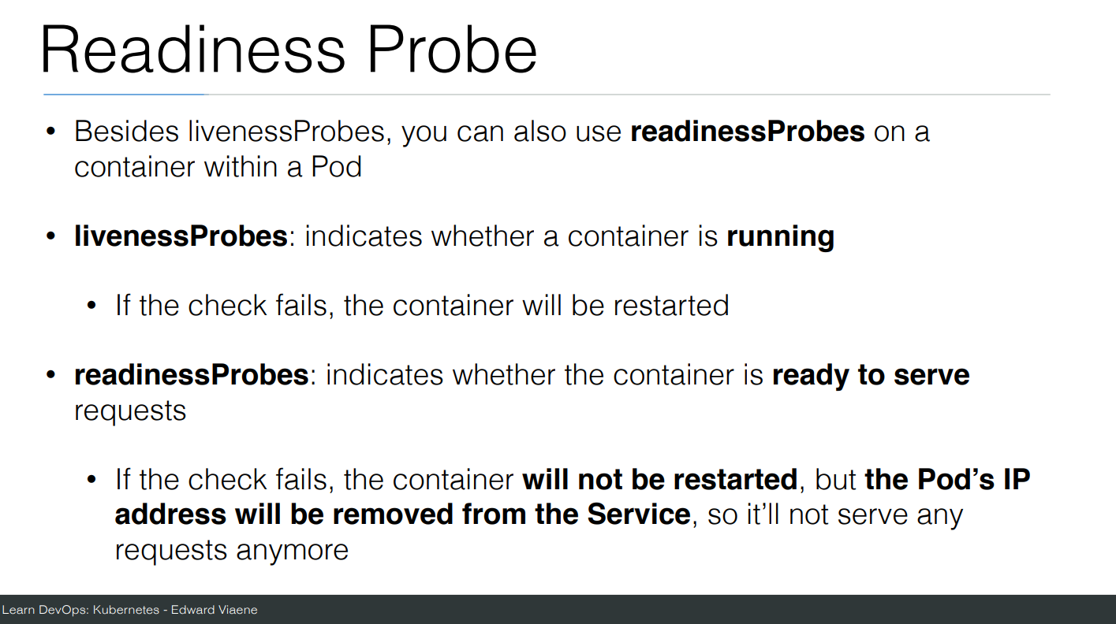

Slide 31
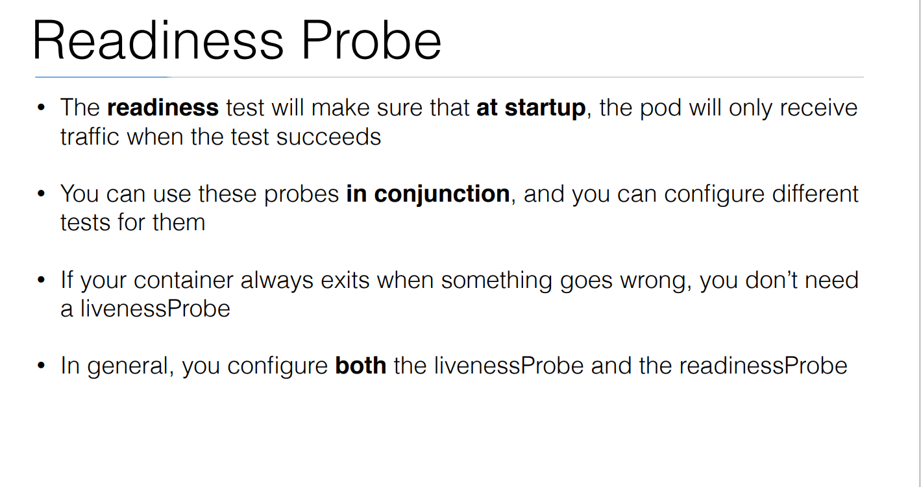

Slide 32
Commands
Create a file helloworld-liveness-readiness.yml
kubectl create -f helloworld-liveness-readiness.yml && watch -n1 kubectl get pods

